Slide 1
Progressive Web Apps
Senaj Lelic
Trainer
WW Education

Slide 2











A PWA is
Progressive
Works on any device and enhance functionality progressively.
Performant
Works as fast or faster than a native app.
Linkable
Ability to retain or reload its state and be shareable from a link.
Responsive
Fit any device’s form factor and screen size.
App-like
Looks like a native app and uses the application shell model with minimal page refreshes.
Connectivity-agnostic
Works with low connectivity or offline.
Installable
Install on the device’s desktop, start menu, or task bar making it readily available.
App-like
Connectivity-agnostic
Progressive
Re-engageable
Promotes re-engagement through features such as push notifications.
Discoverable
Better discovery and integration with search.
Connected to users
Direct feedback to you through ratings and reviews
Current
Application and content is up to date when connected to the Internet.
Notes:
We hear about benifits to building a PWA from developers, next slides will dig into the benifts for you

Slide 3
Why PWA? – Our Goal
The very best experience for your Web content will be on Windows.

Slide 4
Keep your workflow for web
Web
The same app runs across browsers and can take advantage of PWA features as needed / supported.
Build
Deploy
Publish App
Web Content
PWA
The same app serve as a store app with even more features and additional reach to store users.
Build
Build with web technology and web developers.
No need to find and hire c# developers.
Deploy
The work flow for web and PWAs are shared, so your deploy process doesn’t need to change to accommodate PWA.
Publish App
Your PWA “app container” needs only to be published once.
The content is always up to date because it comes from the web.
Notes:
We are not asking you to do anything different. This is maintained just like your website. There is a one time publish to the windows store

Slide 5



CROSS PLATFORM
X
PROGRESSIVE
WEB APPS
Devices + IoT
PC
Xbox
Surface Hub
HoloLens
ACROSS WINDOWS
Notes:
In every modern browser on every platform, Edge, Windows 10, Chrome, Chrome OS, Android, Firefox, Safari, iOS, MacOS

Slide 6
Minimum Viable – Progressive Web App
HTTPS
Web App Manifest
Service Worker

Slide 7
W3C Manifest Demo

Slide 8
Web Application Manifest
{
"lang": "en",
"short_name": "Wash Post",
"name": "The Washington Post",
"icons": [
{
"src": "img/launcher-icon-2x.png",
"sizes": "96x96",
"type": "image/png"
},
{
"src": "img/launcher-icon-4x.png",
"sizes": ”512x512",
"type": "image/png"
}
],
"start_url": "/pwa/?utm_source=homescreen",
"display": "standalone",
"orientation": "portrait",
"background_color": "black"
}

Slide 9
Web Application Manifest
{
"lang": "en",
"short_name": "Wash Post",
"name": "The Washington Post",
"icons": [
{
"src": "img/launcher-icon-2x.png",
"sizes": "96x96",
"type": "image/png"
},
{
"src": "img/launcher-icon-4x.png",
"sizes": ”512x512",
"type": "image/png"
}
],
"start_url": "/pwa/?utm_source=homescreen",
"display": "standalone",
"orientation": "portrait",
"background_color": "black"
}

Slide 10
App display Property
Next version of Windows
Browser
Standalone UI
Minimal UI
Runs in Edge as a separate windows or Tab.
Full browser UI, no store listing
Runs in App container in separate process.
No browser UI, back button only.
Microsoft store listing
Runs in App container in separate process.
Limited UI (navigation & read only nav bar).
Microsoft store listing

Slide 11
Network request - Typical
Web App
Network
Notes:
This represents a typical network request

Slide 12


Network request - Service Worker in play
Web App
Service Worker
Network
Cache
Notes:
It can even go to the network and then store a copy for later

Slide 13
Service Worker Demo

Slide 14
Step 1: Register a Service Worker
if ( navigator.serviceWorker ) {
if ( navigator.serviceWorker.controller ) {
console.log('There’s an active service worker');
} else {
navigator.serviceWorker.register('/sw.js')
.then(function(reg) {
console.log('SW registered for scope', reg.scope);
}); }
}

Slide 15
Step 1: Register a Service Worker
if ( navigator.serviceWorker ) {
if ( navigator.serviceWorker.controller ) {
console.log('There’s an active service worker');
} else {
navigator.serviceWorker.register('/sw.js')
.then(function(reg) {
console.log('SW registered for scope', reg.scope);
}); }
}
This tests to see if Service Workers are supported.

Slide 16
Step 1: Register a Service Worker
if ( navigator.serviceWorker ) {
if ( navigator.serviceWorker.controller ) {
console.log('There’s an active service worker');
} else {
navigator.serviceWorker.register('/sw.js')
.then(function(reg) {
console.log('SW registered for scope', reg.scope);
}); }
}
We can also see if there’s a Service Worker already running.

Slide 17
Step 1: Register a Service Worker
if ( navigator.serviceWorker ) {
if ( navigator.serviceWorker.controller ) {
console.log('There’s an active service worker');
} else {
navigator.serviceWorker.register('/sw.js')
.then(function(reg) {
console.log('SW registered for scope', reg.scope);
}); }
}
If there isn’t, we can register one.

Slide 18
Step 1: Register a Service Worker
if ( navigator.serviceWorker ) {
if ( navigator.serviceWorker.controller ) {
console.log('There’s an active service worker');
} else {
navigator.serviceWorker.register('/sw.js')
.then(function(reg) {
console.log('SW registered for scope', reg.scope);
}); }
}
By default, a Service Worker is scoped to its path.

Slide 19
Step 2: Start manipulating requests
addEventListener('fetch', function(evt) { evt.respondWith(
fromCache(evt.request)
.catch(fromServer(evt.request)));
evt.waitUntil(update(evt.request));
});

Slide 20
Step 2: Start manipulating requests
addEventListener('fetch', function(evt) { evt.respondWith(
fromCache(evt.request)
.catch(fromServer(evt.request)));
evt.waitUntil(update(evt.request));
});
In a Service Worker we can intercept any network requests (“fetch”).

Slide 21
Step 2: Start manipulating requests
addEventListener('fetch', function(evt) { evt.respondWith(
fromCache(evt.request)
.catch(fromServer(evt.request)));
evt.waitUntil(update(evt.request));
});
And we can control the response. In this case responding from the cache first.

Slide 22
Step 2: Start manipulating requests
addEventListener('fetch', function(evt) { evt.respondWith(
fromCache(evt.request)
.catch(fromServer(evt.request)));
evt.waitUntil(update(evt.request));
});
If no cached response is found, we can go to the network.

Slide 23
Step 2: Start manipulating requests
addEventListener('fetch', function(evt) { evt.respondWith(
fromCache(evt.request)
.catch(fromServer(evt.request)));
evt.waitUntil(update(evt.request));
});
We can also update the cache for the next time the request is made.

Slide 24
PWAs in the Microsoft Store

Slide 25

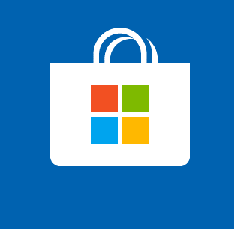
Getting Into the store
Auto Indexing (beta)
Self Publishing
Bing Discovers PWAs on the Web and are automatically reviewed and listed into the store
Developer opens a dev account for the Microsoft Store and publishing app under dev name.

Slide 26
Taking ownership of App
Open a dev account at
dev.microsoft.com
Show ownership of web app
Request transfer to reportapp@microsoft.com

Slide 27
How to NOT get published
No manifest, no https or no offline capability
Robot.txt file telling Bing to ignore manifest
Display: browser
Service request to store to remove app (reportapp@microsoft.com)
😪

Slide 28

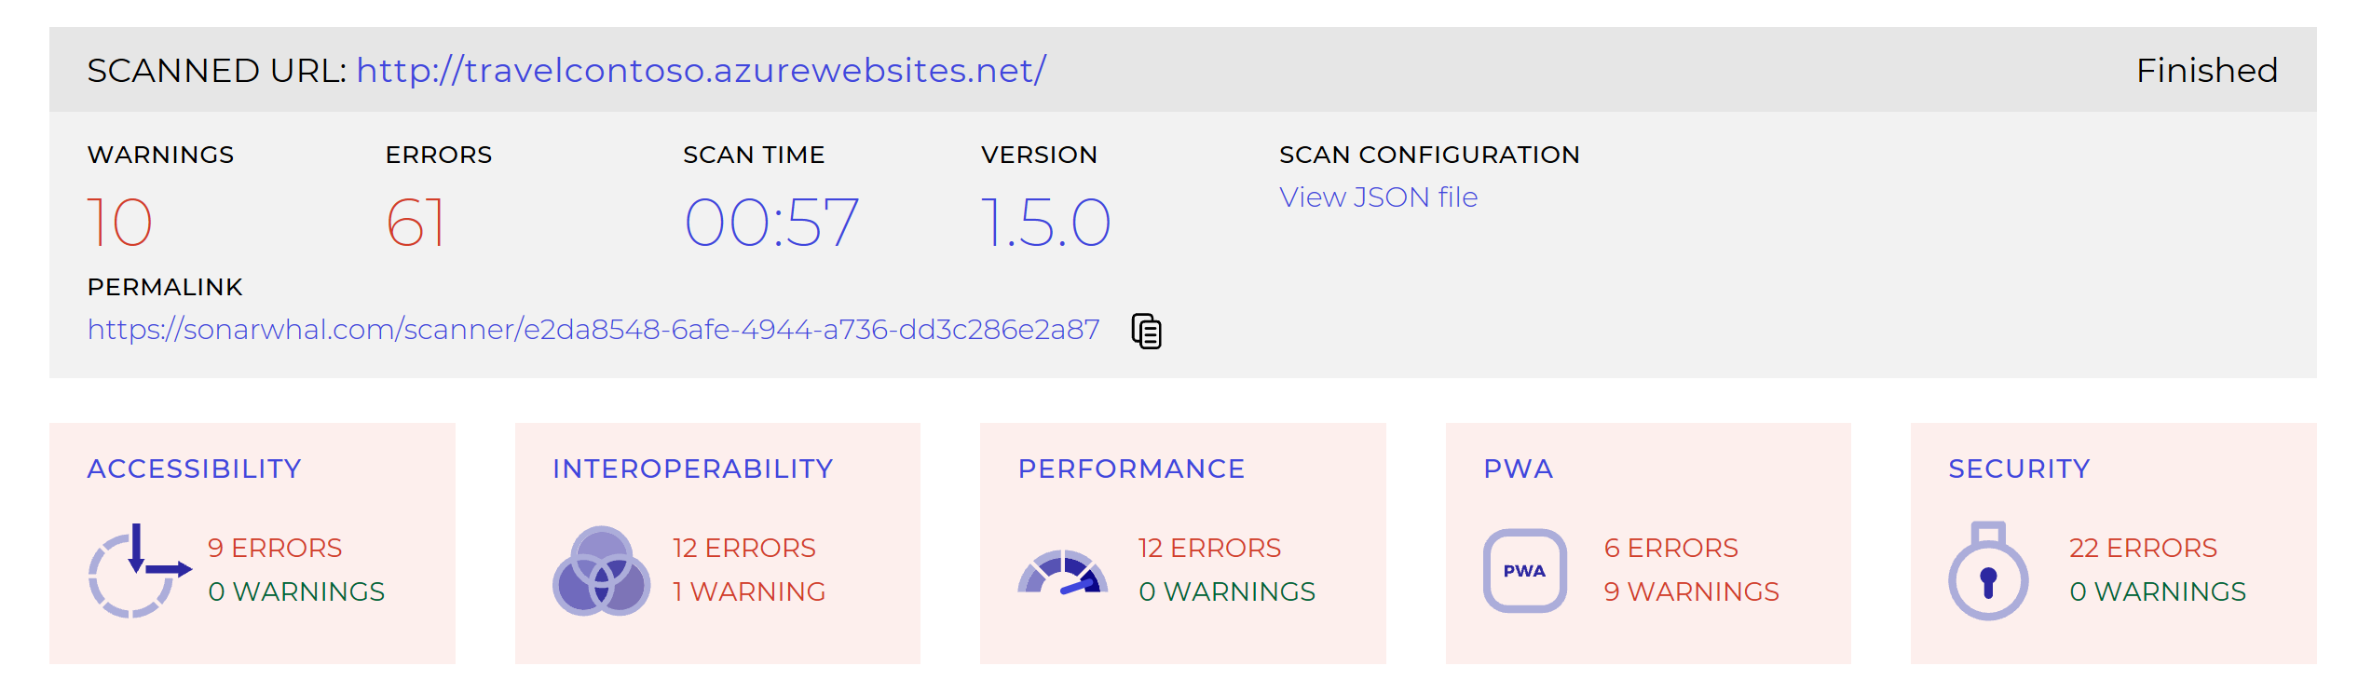
Validate your PWA is ready for Microsoft Store
Improve perf and User Experience

Slide 29

Self Publishing of App
Open / Maintain active Dev center Account
Adhere to Microsoft Store policies
Generate Appx with VS, pwabuilder CLI, or on PWABuilder.com

Slide 30
Packaging & Sideloading for the Windows Store Demo

Slide 31
PWAs on Windows: Awesomeness

Slide 32
Value Add of Windows Store App
Dev Center analytics
In app Purchases
Promotability
No Data Storage Caps
Service Workers
Windows API access

Slide 33
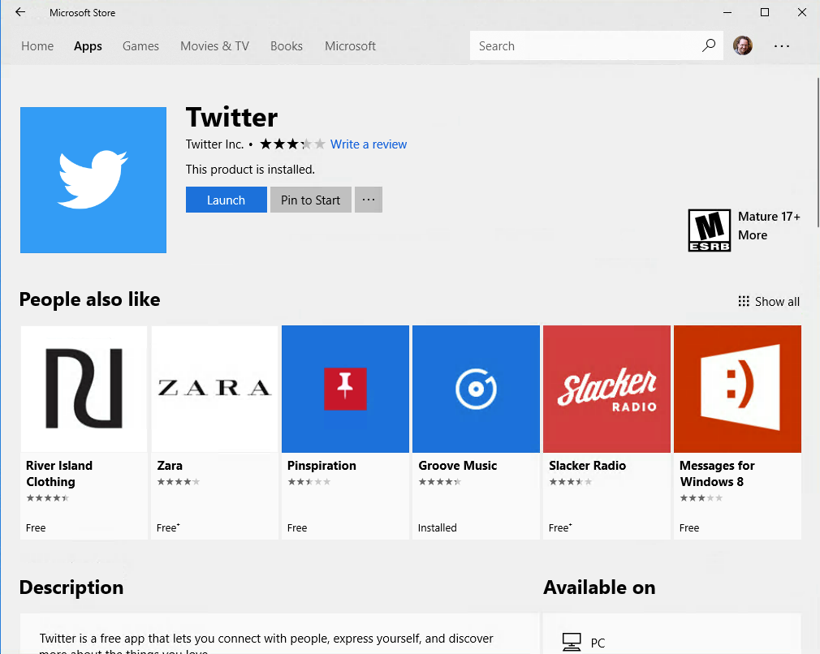

Slide 34
Windows API in a PWA Demo

Slide 35
Access OS-level APIs Dark theme
// Am I installed in Windows? if ( window.Windows ){ // Change the theme var uiSettings = new Windows.UI.ViewManagement.UISettings();
var color = uiSettings.getColorValue(
Windows.UI.ViewManagement.UIColorType.background
if(color.b === 0){
document.body.classList.add('dark')
};
}

Slide 36
Access OS-level APIs Share API
// Am I installed in Windows? if ( window.Windows ){ const dataTransferManager = Windows.ApplicationModel.DataTransfer.DataTransferManager.getForCurrentView();
dataTransferManager.addEventListener("datarequested", handleShareEvent);
//show the share dialogue
Windows.ApplicationModel.DataTransfer.DataTransferManager.showShareUI();
}
https://gist.github.com/comp615/a1c794dbcfa94a6ee051ff938766bfbd (thanks Charlie!)
Notes:
Talk about standar and mapping when standard is

Slide 37
Access OS-level APIs Secondary Pinning
// Am I installed in Windows? if ( window.Windows ){ // pin a secondary tile tile = new Windows.UI.StartScreen.SecondaryTile(tileId, text, text, activationArguments,newTileDesiredSize, logoUri);
//place activation
var buttonCoordinates = { x: SR.left, y: SR.top, width: SR.width, height: SR.height };
var placement = Windows.UI.Popups.Placement.above;
}

Slide 38
PWA Activation Object launch event
// Am I installed in Windows? document.AddEventListiner ( 'activated' function(e){
if(e.eventParamter.activated.value){
//activation value passed
}
})

Slide 39
Calling C# / C++ from PWA
PCL or Custom WinRT object which has been “allowed for Web”
Package PWA in Visual Studio (for now)
Classes Exposed in DOM as native JavaScript object
Used for
Code reuse
Calling non-accessible APIs
Performance

Slide 40
Calling C# from a webview
namespace CommunicationWinRT
{
[Windows.Foundation.Metadata.AllowForWeb]
public sealed class CommunicationWinRT
{
public CommunicationWinRT()
{
}
public String GetValue()
{
return "From my WinRT component Yo!";
}
}
}

Slide 41
Calling C# from a webview
document.getElementById('toast').addEventListener('click', function () {
if (window.CommunicationWinRT) {
testToast.toastMessage(document.getElementById('input').value, 0)
} else {
alert(document.getElementById('input').value)
}
})
if (window.CommunicationWinRT) {
var testToast = new CommunicationWinRT.CommunicationWinRT();
}

Slide 42
Remember:
PWAs are part of Windows to enable Web developers to build great user experiences.
PWAs can indexed or be added to the Microsoft store by the developer.
PWAs are powerful, flexible and extensible on Windows.
We’re not done yet!

Slide 43
Slide palette info
The PowerPoint palette for this template has been built for you and is shown below.
Avoid using too many colors in your presentation.
PowerPoint Theme Accent colors
Accent 1
Accent 2
Accent 3
Accent 4
Accent 5
Accent 6
Use Accent 1 as the main accent color.
Use Accent 2 and Accent 3 only when additional colors are needed.
Use Accents 4-6 sparingly

Slide 44
aka.ms/insiderdevtour-labs
Move your website to a PWA
Make your web app run offline
Take advantage of PWA APIs

